Slide 1
Achieving New England’s Clean Electricity Future
The Forward Clean Energy Market (FCEM) and Integrated Clean Capacity Market (ICCM) Pathways
December 2020
Presented to
Presented by
New England Electricity Restructuring Roundtable
Kathleen Spees

Slide 2
Overview: What is the “Forward Clean Energy Market”?
The FCEM would be a centralized, forward auction in which buyers and sellers could voluntarily exchange clean energy attribute credits (CEACs). Capacity would be procured after the FCEM in the FCM
Voluntary Buyers
States · Retailers · Companies · Cities · Utilities · Public Power
Price
$/MWh
Qualified Sellers
Wind · Solar · Nuclear · Hydro · Other Qualified Clean Energy
Competitive Clearing Price and Quantity
Demand Bids
Supply Offers
CEAC MWh
  3-year forward auction
  Unbundled CEAC product
  7-12 year price lock-in for new resources
See Detailed FCEM Design Proposal with State Design Options (link)

Slide 3
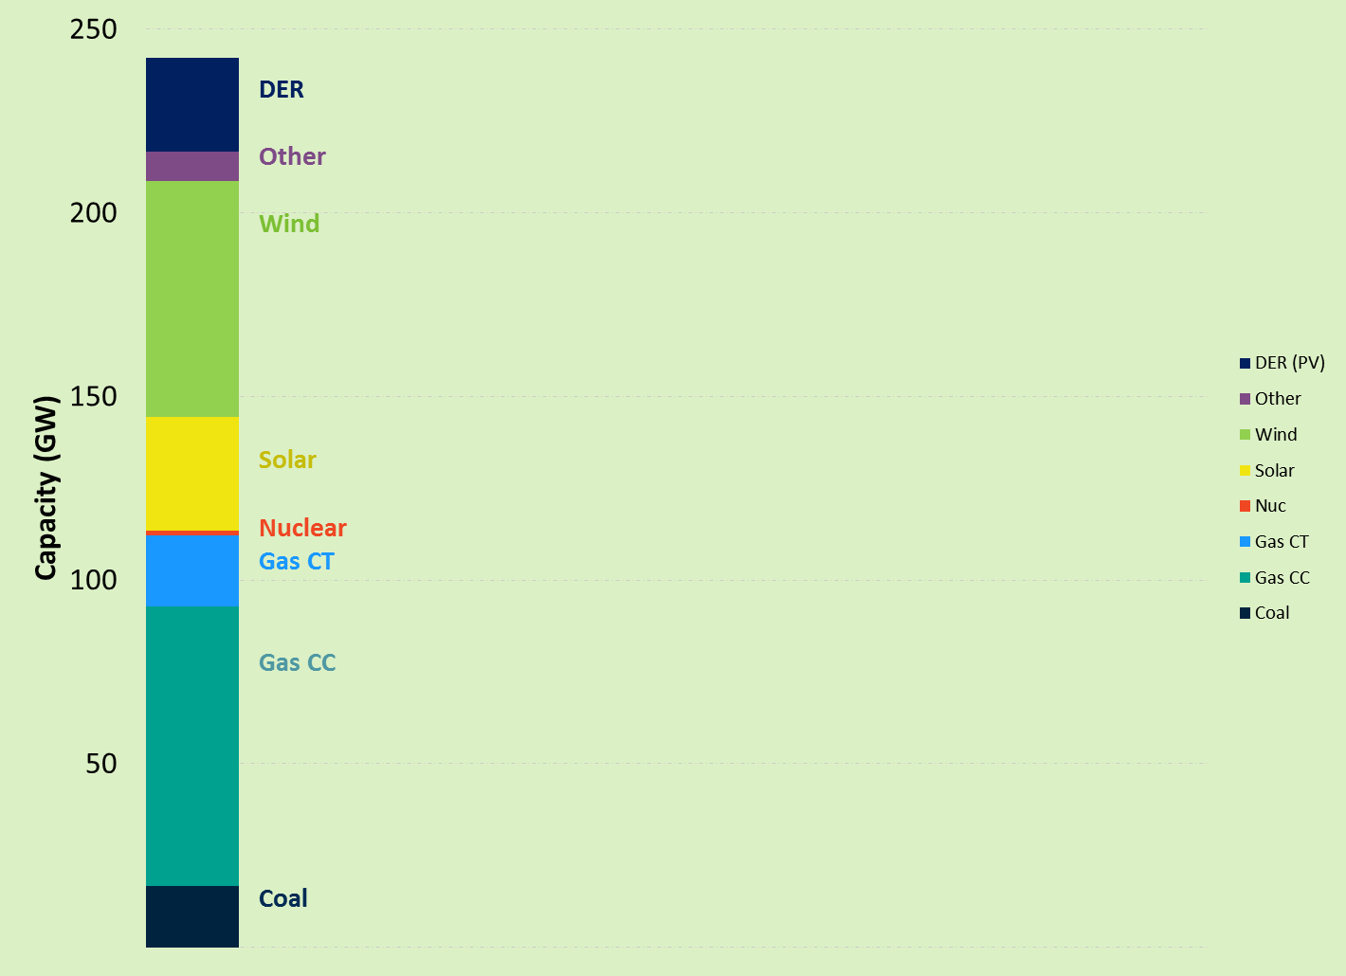
Overview: What is the “Integrated Clean Capacity Market”?
BIDS
CO-OPTIMIZED AUCTION CLEARING
CLEARING RESULTS
Demand
Similar to the FCM Clearing
Objective function: Maximize social surplus (area under demand curves minus cleared resource cost)
Cleared resources: Least cost resources for meeting capacity & CEAC demand
Price setting: Marginal cost of meeting incremental demand
Clearing Prices
Cleared Resources
Capacity (MW)
Clean Energy (CEACs)
Capacity (MW)
Supply
Total annual resource cost ($) Capacity quantity (UCAP MW) Clean attribute quantity (CEAC)
Clean Energy (CEACs)
See Additional Detail (link)

Slide 4
FCEM and ICCM Key Design Elements
Design Element | Resource Adequacy Objectives | Clean Electricity Objectives
Responsible Entity for Defining the Need | ISO New England | State policymakers Voluntary buyers (retailers, companies)
Product Definition | Unforced capacity (UCAP MW) Keep locational specificity (as today) Consider also specifying: separate summer and winter products & “flexible” capacity needs | Clean energy attribute credit (CEAC) States would make an effort to align definitions into a uniform product to the extent possible (though multiple products would be accommodated as needed) Consider: “dynamic” CEAC product
Supply Eligibility | All clean and fossil resources are eligible ELCC-based accounting for resource-neutral capacity values (by location, season, and flexibility) | All clean resources are eligible for a “base” product All revenues are considered “in market” States can specify technology (but aim to limit the number and size to maximize competition)
Quantity to Procure | Quantity needed to support 1-in-10 Based on advanced reliability modeling that considers resource characteristics & flexibility needs in the clean grid | States and customers decide the quantity needed Pre-existing contracts are fully accounted for in this market as self-supply
Willingness to Pay | Sloping demand curves for each capacity product Hierarchy of needs reflected in price formation (e.g. import-constrained and “flexible” capacity prices are equal or greater than system/traditional capacity prices) | States submit sloping demand curves for state-mandated CEAC demand Voluntary buyers can submit price-quantity pairs to exceed state mandates

Slide 5
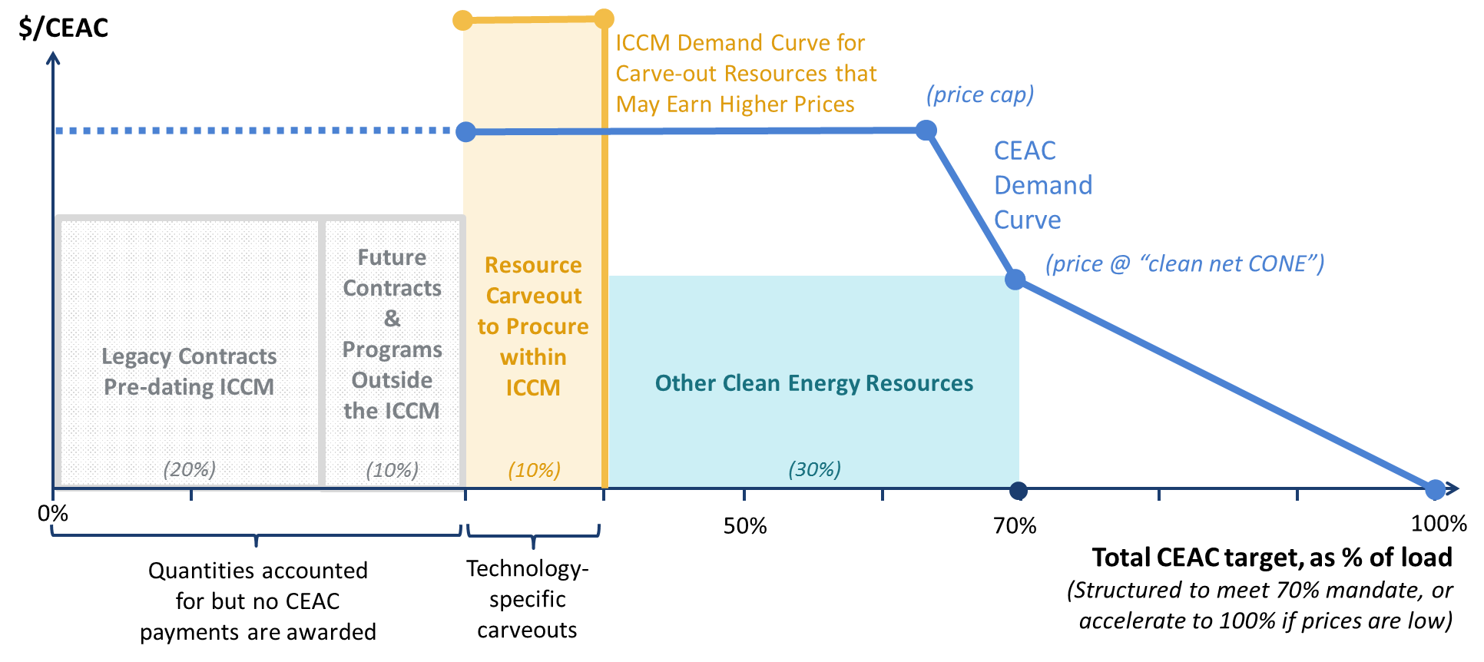
How would states express demand for clean energy?
Example: Illustrative demand curve for a state with a 70% clean energy mandate, technology specific carve-outs, and existing programs

Slide 6
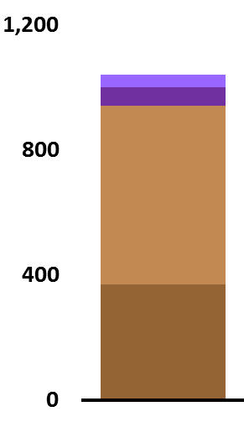
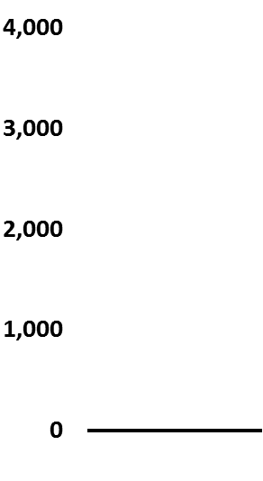
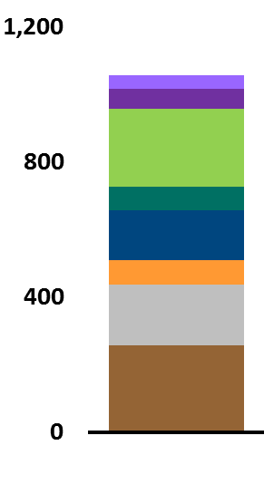
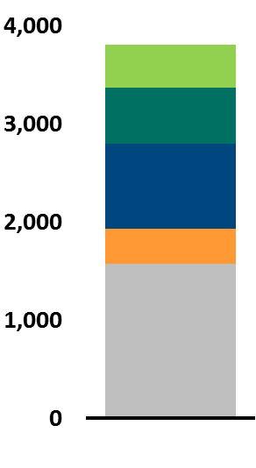
What resources clear?
Traditional Capacity Market
Integrated Clean Capacity Market
Cleared Capacity
UCAP MW
Cleared CEACs
GWh
Cleared Capacity
UCAP MW
Cleared CEACs
GWh
EE
EE
DR
DR
Storage
Wind
Hydro
Gas
Solar
Nuclear
Gas
Note: Auction clearing and pricing is model available upon request.
Simplified example is not intended to reflect New England.

Slide 7
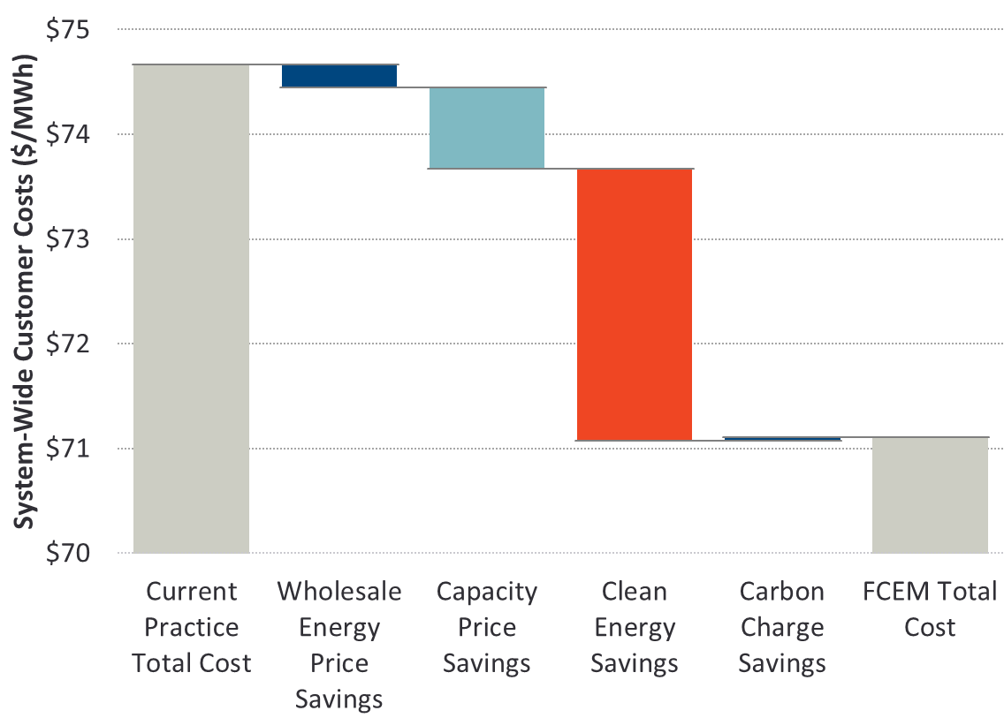
Market-based procurement of clean energy could result in significant cost savings to customers
New England Customer Cost Savings
FCEM vs. Current Practice
  Our New England
  simulations in Brattle’s GridSIM model estimated that FCEM could save customers approximately $4.5 billion & abate 7.4 additional Megatonnes of CO₂ over ten years
  compared to traditional state contracting
Source: Kathleen Spees, Judy Chang, DL Oates, and Tony Lee, “A Dynamic Clean Energy Market in New England,” November 2017, The Brattle Group. Modeling results reported over a ten year period 2020-2029.

Slide 8
Why should New England consider some variation of the FCEM or ICCM?
  Carbon pricing alone may be insufficient: Carbon pricing alone is a first-best economic solution if it can be implemented broadly (regionally, across economic sectors, and at a price high enough to meet policy goals). States have expressed that this path is less likely to succeed at the present time due to differences among state policies, lack of federal policy, and the twin objective to support electrification
  Robust to a range of carbon prices: FCEM or ICCM can be implemented with or without enhanced carbon pricing. Maintains option value if states wish to achieve benefits from enhanced carbon pricing (but cannot agree on a price high enough to achieve policy objectives)
  FCEM avoids the “leakage” problems from carbon prices that differ between markets
  States maintain total flexibility to utilize the market as much or as little as desired, ramp up reliance on the market as it demonstrates success, and pursue their own policy objectives without requiring any agreement on a common price or policy goal
  States & customers pay to meet their own goals (no cost-shifting to non-participants)
  Leverages design features proven to attract new investments at competitive prices in the power sector (demand curve, forward auction, multi-year price lock-in for new resources, broad competition)

Slide 9

Contact Information
Dr. Kathleen Spees is a principal at The Brattle Group with expertise in wholesale electricity markets design and environmental policy analysis.
    Dr. Kathleen Spees is a Principal at The Brattle Group with expertise in designing and analyzing wholesale electric markets and carbon policies. Dr. Spees has worked with market operators, transmission system operators, and regulators in more than a dozen jurisdictions globally to improve their market designs for capacity investments, scarcity and surplus event pricing, ancillary services, wind integration, and market seams. She has worked with U.S. and international regulators to design and evaluate policy alternatives for achieving resource adequacy, storage integration, carbon reduction, and other policy goals. For private clients, Dr. Spees provides strategic guidance, expert testimony, and analytical support in the context of regulatory proceedings, business decisions, investment due diligence, and litigation. Her work spans matters of carbon policy, environmental regulations, demand response, virtual trading, transmission rights, ancillary services, plant retirements, merchant transmission, renewables integration, hedging, and storage.
    Dr. Spees earned her PhD in Engineering and Public Policy within the Carnegie Mellon Electricity Industry Center and her MS in Electrical and Computer Engineering from Carnegie Mellon University. She earned her BS in Physics and Mechanical Engineering from Iowa State University.
Kathleen Spees Principal, Washington DC +1.202.419.3390 Kathleen.Spees@brattle.com

Slide 10
Appendices

Slide 11
Transition to New England’s Future Grid
Forward Clean Energy Market
A Market-based Option for States to Achieve their Clean Electricity Goals
Presented by
  Kathleen Spees
  Study Co-Authors
  Samuel Newell
  Walter Graf
  David Luke Oates
  Judy Chang
    July 2020
    Full studies:
High-Level FCEM Proposal and New England Economic Impact analysis (link)
Detailed FCEM Design Proposal with State Design Options (link)

Slide 12
First: What Are We Trying to Do Here?
Current ISO Markets Are Designed to Achieve:
Reliable & Low-Cost Electricity
But by 2050 New England Needs: Reliable, Low-Cost & Carbon-Free Electricity
Gas Plants
Storage
Markets designed for this purpose will attract and retain….
DR
Hydro
Solar
Wind
Nuclear
Market forces may drive carbon emissions up or down
Market drives 80% carbon reductions at least cost

Slide 13
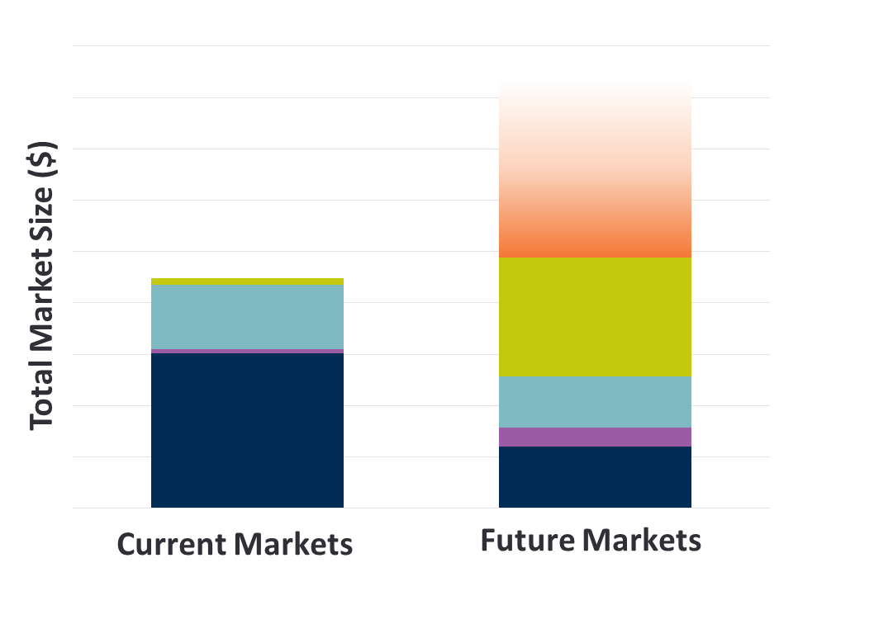
Second: What Do the “Future Markets” Look Like?
Best Market Design
(20 Years Ago)
Best Market Design
(20 Years from Now)
Adjacent
Customer
Products and Services
Clean Energy Attribute Markets
Capacity
Flexibility & Ancillaries
Energy
New Markets
Are needed to meet carbon objectives & mobilize the grid edge
FCEM, CO₂ pricing, or other markets for achieving state goals.
Existing Markets
Need to be re-thunk. Start by assuming that “nontraditional” resources are the new normal
Designed for ….
Dispatchable thermal plants, inelastic demand
Intermittent wind & solar, storage, EVs, DR, interties, prosumers

Slide 14

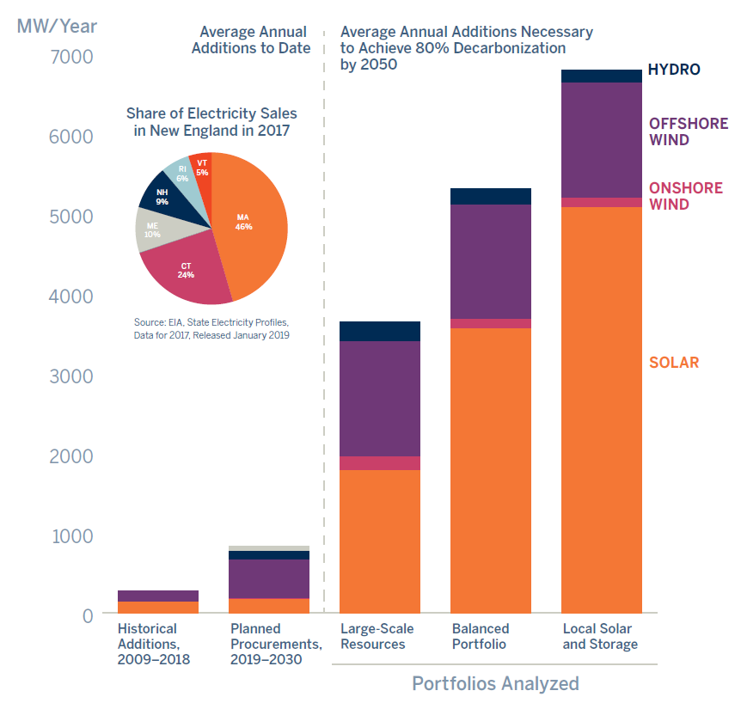
Third: How Do We Get There?
New England Clean Energy Needs
Average Annual Clean Energy Additions
Needed to Achieve “80 by 50” Goals
Thousands of MW of new clean resources will need to be built every year to meet policy goals and customer demand
Missing building block in the “future markets”: Some of the states may want to utilize a market-based option achieve their policy goals (not just accommodate)
We developed the Forward Clean Energy Market (FCEM) as one tool that states could use for mobilizing private investment to meet their goals through a competitive market
Source: Brattle Study “Achieving 80% GHG Reduction in New England by 2050”

Slide 15

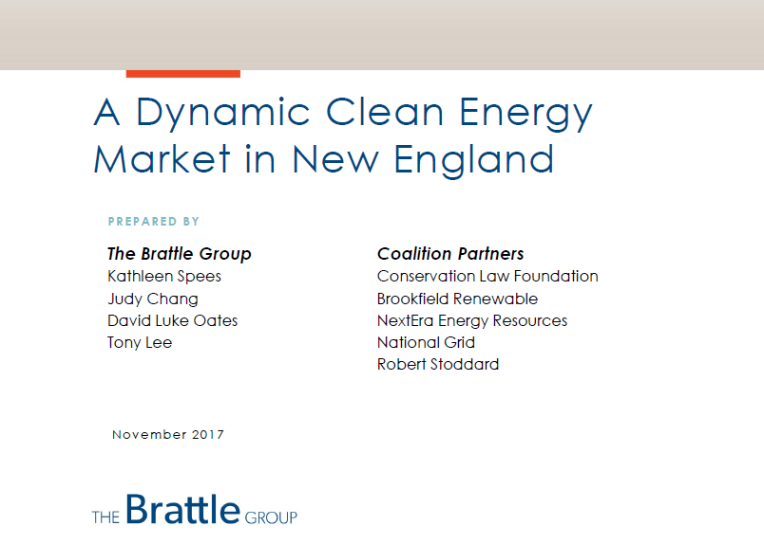
Refresher: What is the Forward Clean Energy Market?
High-Level FCEM Proposal and New England Economic Impact analysis (link)
Detailed FCEM Design Proposal with State Design Options (link)
Design concept originated in the IMAPP process with input from many states & stakeholders. Developed across two studies…

Slide 16
How Does FCEM Fit into the Range of “Achieve” Options that the States Might Consider?
FCEM is one promising option for New England states to consider for part or all of their clean energy procurement goals
Integrated Resource Planning | State Contracting |  | Forward Clean Energy Attribute Market |  | Carbon Pricing
 | More Targeted Bundled contracts Technology-specific Regionally limited | More Competitive Unbundled attributes Regional Technology neutral | More Targeted Technology-specific or new resource carve-outs | More Competitive Region-wide Technology neutral | More Targeted Electricity sector only Lower carbon price | More Competitive Region-wide Economy-wide Higher carbon price
FCEM is a family of approaches that can be tailored to the specific needs of each state and the broader New England region

Slide 17
What is the Forward Clean Energy Market?
The FCEM would be a centralized, forward auction in which buyers and sellers could voluntarily exchange clean energy attribute credits (CEACs)
Voluntary Buyers
States · Retailers · Companies · Cities · Utilities · Public Power
Price
$/MWh
Qualified Sellers
Wind · Solar · Nuclear · Hydro · Other Qualified Clean Energy
Competitive Clearing Price and Quantity
Demand Bids
Supply Offers
CEAC MWh
  3-year forward auction
  Unbundled CEAC product
  7-12 year price lock-in for new resources

Slide 18
Design Overview
The FCEM could incorporate the best practices of existing wholesale electricity markets while enabling states to express their own policy goals
Unbundled Clean Energy Attributes to maximize competition across markets and technologies States and Customers Choose their own demand quantities and willingness to pay (no costs shifted to non-participants) Broad regional competition Technology-neutral qualification and payments (option for technology carve-outs) | Mechanisms to mitigate regulatory risk and ensure financeability at competitive costs Option for product definition that matches the underlying objective (carbon abatement), or combine with higher carbon prices to achieve similar outcomes Alignment with energy, ancillary, and capacity markets

Slide 19
Design Overview: Basic Framework is Straightforward, But There are a Number of Options to Consider
Design Element | Approach
Product Definition | The product is an unbundled Clean Energy Attribute Credit (CEAC), similar to an unbundled Renewable Energy Credit (REC) Optional Variation: Design option for a “dynamic” CEAC accounting approach that awards more CEACs to resources that displace more carbon emissions. This approach can readily enable batteries and focus incentives toward achieving more carbon abatement faster
Demand Participation in the Forward Auction | State demand would be expressed as a sloping demand curve that will buy higher quantities if supply is available at lower cost Additional voluntary demand bids can be submitted by cities, public power entities, customers, companies, retail providers, or others. These bids are expressed as price-quantity pairs, representing the willingness to pay for CEACs Optional Variation: Buyers will have an option to submit a preference for “targeted” resource types, for example to meet carve-outs for preferred technologies such as storage or offshore wind. The auction may procure these resource types even if they are higher cost than “base” resources, although the buyer can specify a limited willingness to pay such a premium
Technology-Neutral Supply Participation | Resources are not restricted by type, location, or generation profile; any new or existing clean resources can participate, including hydro, wind, solar, nuclear, storage, or other Storage resources can participate if their charging and discharging profiles displace system carbon emissions; they offer the value of carbon abatement when discharging, net of any additional carbon emissions they cause when charging
Forward Auction | Forward auction three years before the one-year delivery period to align with development timeline of new clean resources 7-12 year commitment period is available to new resources, over which time the price is locked-in to guarantee revenue stability
Bilateral and Spot Markets | Ongoing trading before and during the delivery year, with a final spot auction after the delivery year. Producers can adjust their positions until the spot auction when any net deficit must be remedied; retailers can continually adjust their positions until the compliance deadline at which point retailers must meet their clean energy obligation or face a compliance penalty
Monitoring and Mitigation | Targeted mitigation measures to prevent large suppliers from exercising market power through physical or economic withholding
Wholesale Market Alignment | Operates well with existing wholesale markets and maintains incentives to maximize energy, flexibility, and reliability value to the grid CEAC-based revenues are counted as “in-market” in the capacity market, i.e. not subject to minimum offer price rule (MOPR) provisions
Competitive Retail Market Alignment | In states with retail choice, the CEAC is implemented as an obligation on retail providers to meet a certain fraction of their delivered load through clean energy, e.g. 50% by 2030 Retailers can comply either by making their own CEAC supply arrangements (with self-supply volumes netted out of auction settlements), or by relying on the centralized auctions (passing the costs on to customers) Retailers compete to offer innovative retail energy options to customers, including additional (up to 100%) clean energy. Retailers can participate in forward, bilateral, and spot markets and develop hedging strategies to minimize cost and risk

Slide 20
What Are the Key Design Features and Choices?

Slide 21
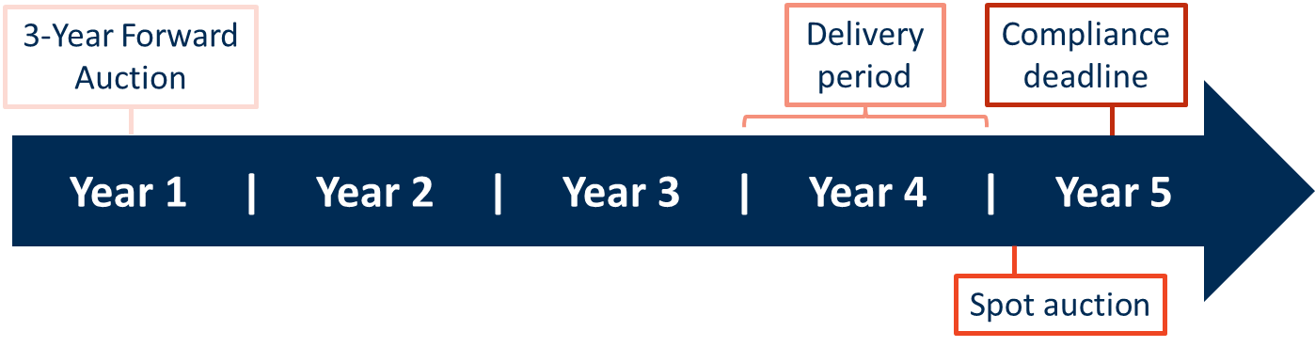
Procurement and Compliance Timeline
Three-year forward procurements are designed to align with developer needs, while fully enabling bilateral agreements retailer self-supply at all timeframes
3-Year Forward Clean Energy Auction
Immediately prior to or co-optimized with the forward capacity auction
Bilateral Market
Pre-auction: Voluntary long-term contracts and forward hedges
Post-auction: Producers and retailers use exchange trades and short-term contracts to manage position relative to obligations and banking value

Slide 22
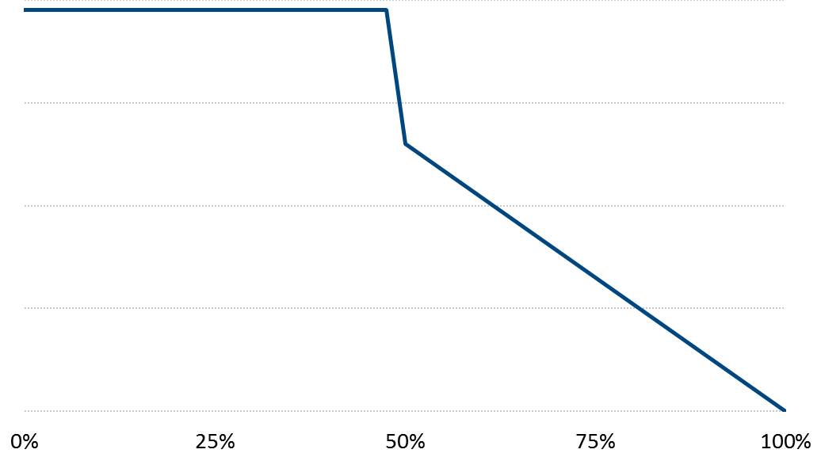
Each State Could Translate Its Own Procurement Target into a Downward-Sloping Demand Curve
Illustrative State Demand Curve for CEACs
Optional: Allow a moderated pace of decarbonization if costs would otherwise exceed a program budget cap
1.5x Reference Price
Reference Price
e.g. based cost of new clean resources, or social cost of carbon
Potential procurement levels based on
performance of other markets
with demand curves
Price for Clean Electricity ($/MWh)
Accelerated
decarbonization by
buying more when
prices are low
Procurement Target
e.g. in 2030
Procured Clean Supply (% of State Electricity Demand)

Slide 23
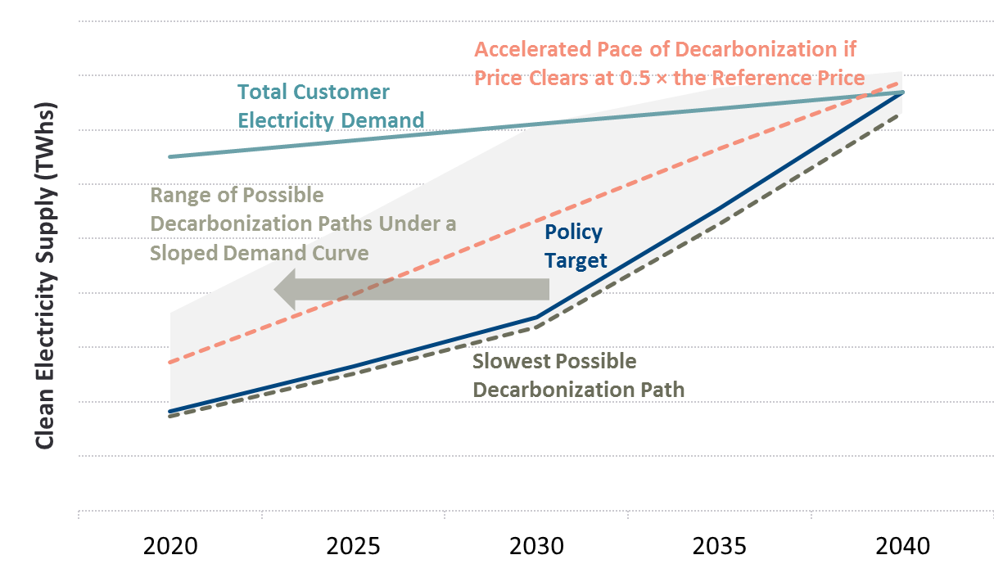
By How Much Could a Demand Curve Accelerate a State’s Clean Electricity Goals?
Potential Pathways to Decarbonization with a Sloping Demand Curve
Example of a State with Clean Energy Targets of 25×2030, 50×2030, and 100×2040

Slide 24
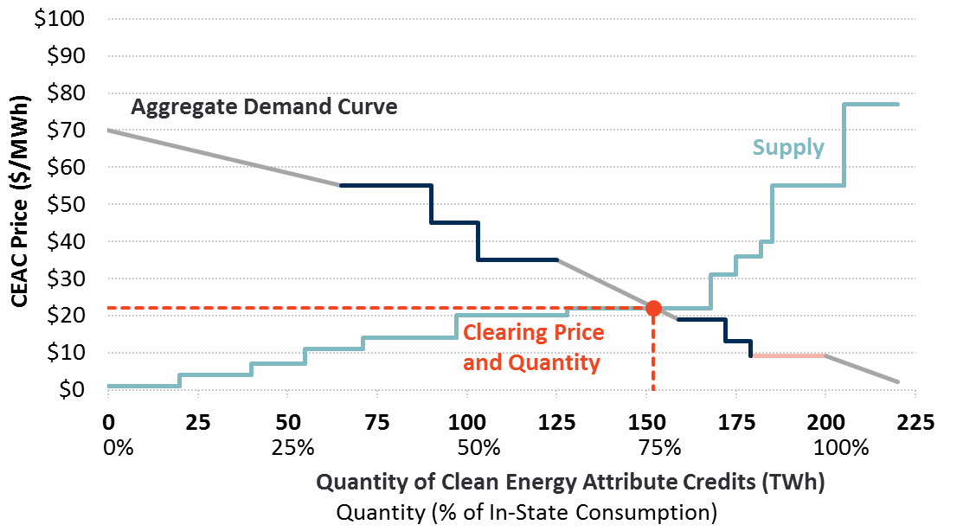
Auction Clearing at a Competitive Price
Cities, companies, and retailers can submit voluntary demand bids for CEACs
State-
Sponsored Demand
Voluntary Demand

Slide 25
Design Option: “Targeted” Resources to Comply with Technology-Specific Requirements
States submit the demand for clean energy and the maximum willingness to pay. States can choose to purchase:
“Base” Resources
“Targeted” Resources
Procures the least cost clean supply, whether new or existing
All resources can participate (hydro, wind, solar, nuclear, storage), no restrictions by type or location
1-year commitments for existing resources; ~7-12 year price lock-in for new
State commitment to submit demand bids in future years, e.g. for 10 years
State carve-outs for new resources
State has option to define a specific type (e.g. for emerging technologies)
~7-12 year anchor price lock-in (resources eligible as “base” supply in years 8+)
No state commitment to submit demand in future years
“Contingent bid” option: If targeted resource prices are too high, demand will revert to purchase lower-cost “base” resources

Slide 26
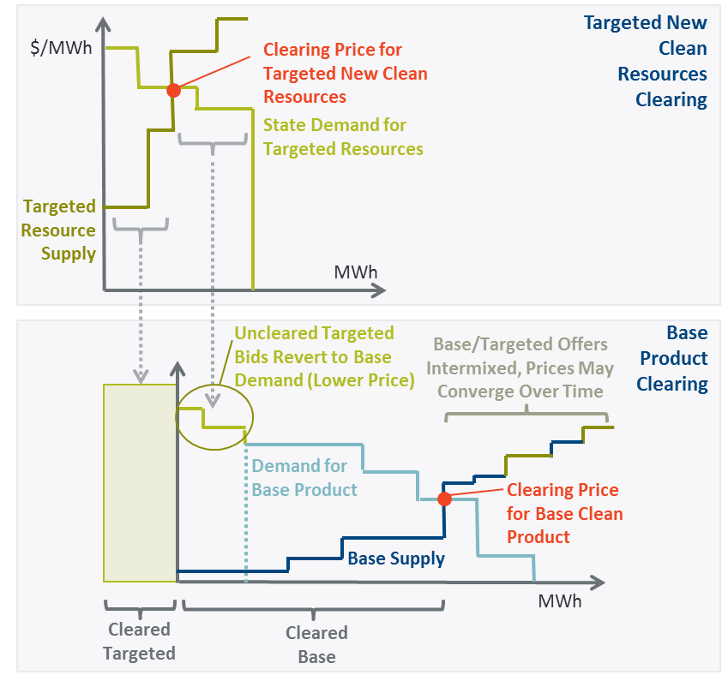
Illustration of Auction Clearing with Targeted Resources

Slide 27
Risk Sharing and Financeability
The FCEM intentionally places most fundamentals-based and asset-specific risks on sellers who would then manage the risks. A few key design features could be used to mitigate regulatory risks and support financeability:
  Multi-Year Commitment Period of around 7-12 years locks in prices for new resources
  Multi-Year Forward Period supports development and financing of new resources
  Sloped Demand Curve mitigates year-to-year price volatility, improving revenue certainty over time
  To enhance confidence in the market, states could make durable commitments to rely on the FCEM for a minimum timeframe & quantity
Allocate Risks to Customers
Allocate Risks to Sellers
Regulatory Risks | Market Fundamentals | Asset-Specific Risks
Unanticipated changes to state policy Unpredictable changes to state demand bids Rule changes | Resource mix Load growth Fuel prices Transmission development Energy, capacity, and ancillary service prices | Construction delays Unanticipated asset costs Asset performance

Slide 28
How Does FCEM Compare to the Other Options for Achieving State Goals?

Slide 29
Customer Cost Savings Relative to Current Practice
  Our New England
  simulations in Brattle’s GridSIM model estimated that FCEM could save customers $3.60/MWh or approximately $4,500 million over ten years
  compared to current practice
Example: New England Customer Cost Savings
Forward Clean Energy Market vs. Current Practice
Source: Kathleen Spees, Judy Chang, DL Oates, and Tony Lee, “A Dynamic Clean Energy Market in New England,” November 2017, The Brattle Group. Modeling results reported over a ten year period 2020-2029.

Slide 30
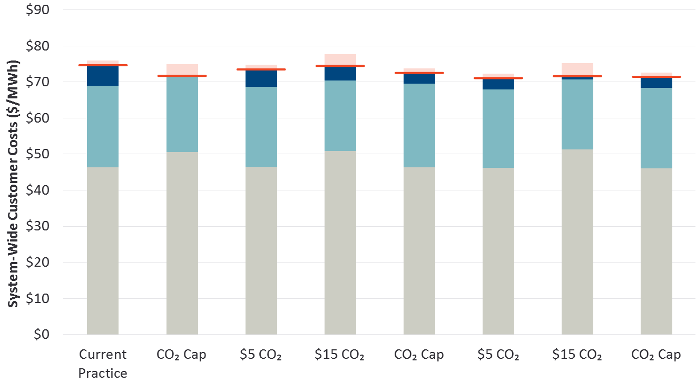
Size of Customer Benefits Varied Depending on Carbon Price and FCEM Design Choices
Our modeling analysis indicated that a range of market-based FCEM and carbon pricing approaches achieved customer benefits. Some more than others!
Current Practice
CO₂ Cap
New-Only Clean Energy Market
Two-Tier New & Existing Clean Energy Market
Rebate of Carbon Charges
Net Customer Cost
Clean Energy Payments
Capacity Payments
Energy + CO₂ Price
Note: Simple average of nominal costs from 2020-2029.

Slide 31
FCEM Can Be Implemented With or Without Higher Carbon Prices
Many economists will advise to focus exclusively on carbon pricing to meet policy goals (and our simulations demonstrate the value). But FCEM offers several benefits beyond considering carbon pricing alone:
Carbon pricing maximizes benefits if implemented regionally and economy-wide (may not be politically feasible in the near term) Carbon prices acceptable to all states are likely too low to achieve policy goals FCEM does not require states, cities and companies to agree on a common price or policy goal FCEM avoids the “leakage” problems from carbon prices that differ between markets States & customers pay to meet their own goals (no cost-shifting to non-participants) Lower developer risk with FCEM than carbon pricing

Slide 32
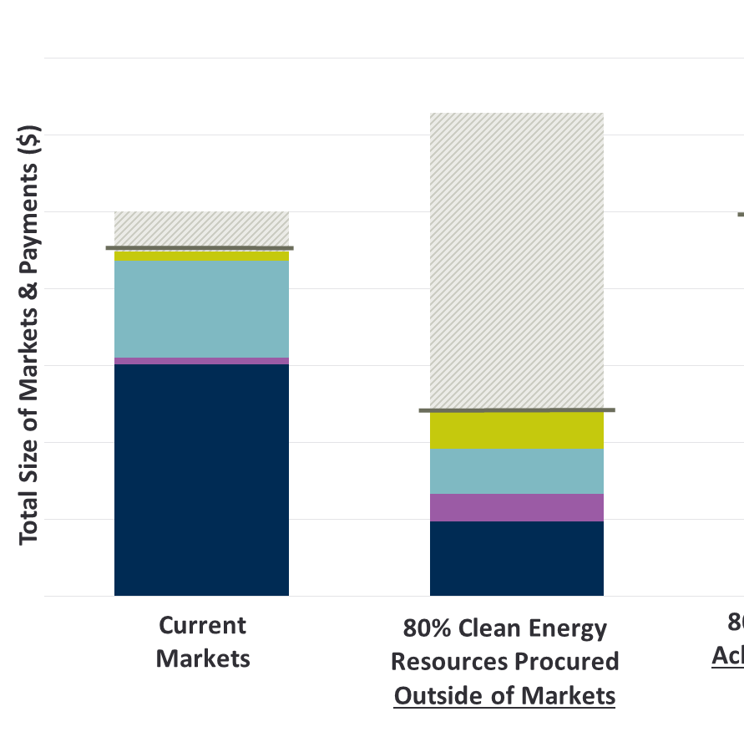
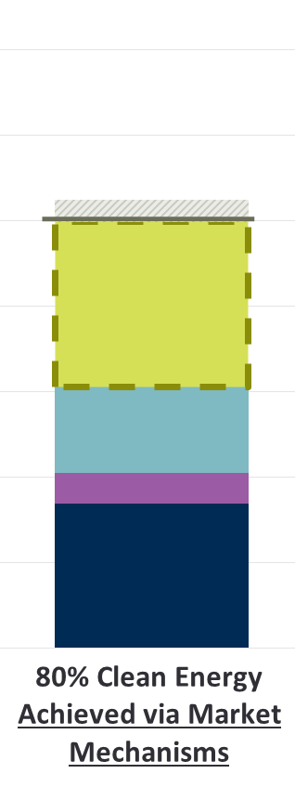
Alignment with Wholesale Markets
The FCEM can align with the merchant investment model, competitive retail markets & enable competitive co-optimization with energy and capacity markets
Today
Future
w/ Traditional State Policies
Future
w/ Clean Energy Attribute
Markets
Contracts & Directed Payments
Forward Clean Energy Market
Capacity Market
Ancillary Services
Energy Market
Possibly with enhanced carbon pricing
Targeted payments and policy-driven contracts will increasingly displace merchant supply
?
Competitive Markets
Align to meet both reliability & policy goals
RECs
Notes:
WG // Also note MOPR here verbally -

Slide 33
Why Consider Variations of the FCEM?
FCEM offers a few advantages specifically in the New England region
  States don’t have to agree on a single goal or carbon price
  States can opt in to the design (or not)
  States can choose how much to buy via FCEM (versus contracts or other approaches)
  Buyer-pays approach ensures no cross-subsidization among the states
  Leverages design features proven to attract new investments at competitive prices in the power sector (demand curve, forward auction, price lock-in, broad competition)
  Fills in one of the critical missing building blocks of the decarbonized “future markets”
Review the full study: Linked Here

Slide 34
Appendix:
Dynamic Clean Energy Attribute
Product Definition

Slide 35
Dynamic CEAC Product: Achieves More Carbon Abatement at Lower Cost
Design Option: Transition to a more advanced product design that focuses incentives on carbon abatement
Traditional RECs:
Equal Incentives Across all Hours
“Dynamic” CEACs:
Incentives Scale to Carbon Displacement
CEACs Awarded Scales with CO₂ Displacement
Marginal System CO₂
Emissions
Marginal System CO₂
Emissions
RECs Awarded = MWh Generation
Flat incentives over every hour
Incentive to offer at negative energy prices during excess energy hours when displacing other clean supply
Payments scale in proportion to marginal CO₂ emissions (by time and location)
Incentive to produce clean energy when and where it avoids the most CO₂ emissions
No incentive to offer at negative prices

Slide 36
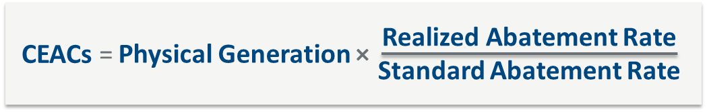
Dynamic CEACs
Clean energy suppliers earn CEAC awards (and thus payments) that scale in proportion to carbon abatement value:
CEACs: annual quantity of CEACs awarded to the clean resource. The rate of CEACs awarded per physical MWh produced may be greater than the average across all clean suppliers (if displacing primarily coal) or less than the average across all clean suppliers (if displacing primarily other clean supply)
Physical Generation: the as-metered MWh produced by the clean resource
Standard Abatement Rate: the standard quantity of marginal carbon displacement required to produce one CEAC (e.g. 1,100 lbs/MWh). This value adjusts over time with the average abatement value across the clean fleet
Realized Abatement Rate: the measured marginal carbon abatement value of the resource in question, based on the time and place of clean energy production
Notes:
WG// Add’l notes on each bullet from report:
CEACs: The rate of CEACs awarded per physical MWh produced may be greater than the average across all clean suppliers (if the resource displaces primarily coal generation) or less than the average across all clean suppliers (if the resource displaces primarily other clean resources).
Standard Abatement Rate: This standardized abatement rate will be established prior to the forward clean energy auction and known to all participants in advance of submitting any offers. It will be established based on the marginal emissions displacement delivered across the entire fleet of clean energy resources as measured in the tracking system over the past three years, with the parameter updated annually. An example is 1,100 lbs of CO₂/MWh.
Realized abatement rate: The realized carbon abatement could be much higher than the standardized rate (e.g. 1,900 lbs/MWh, if the resource is primarily displacing coal generation) or much lower than the standardized rate (e.g. down to 300 lbs/MWh, if the resource is in an export-constrained wind pocket where injecting more supply is primarily displacing other wind generation). The realized abatement rate will be calculated using RTO data on resource-specific 5-minute injections into the grid at a particular node, and the marginal carbon emissions at each node of the power system in each 5-minute nodal pricing interval.

Slide 37
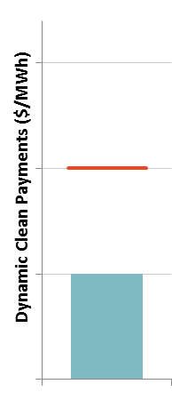
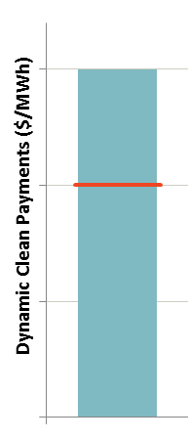
Incentives for Clean Energy in the Right Locations
Varying the CEAC awards across locations in a way that reflects carbon emissions displaced will focus incentives to develop new clean energy where they are most valuable
Low-Emitting Location
Generation pocket that is already saturated with wind. New clean energy will mostly displace the generation of existing wind resources (and will earn fewer CEACs)
High-Emitting Location
Load pocket where high-emitting steam oil units are often called on. Clean energy will displace more emissions (and earn more CEACs)
Realized
CEAC Quantity
At Reference Emissions Abatement
CEACs/MWh
CEACs/MWh
At Reference Emissions Abatement
Realized CEAC
Quantity

Slide 38
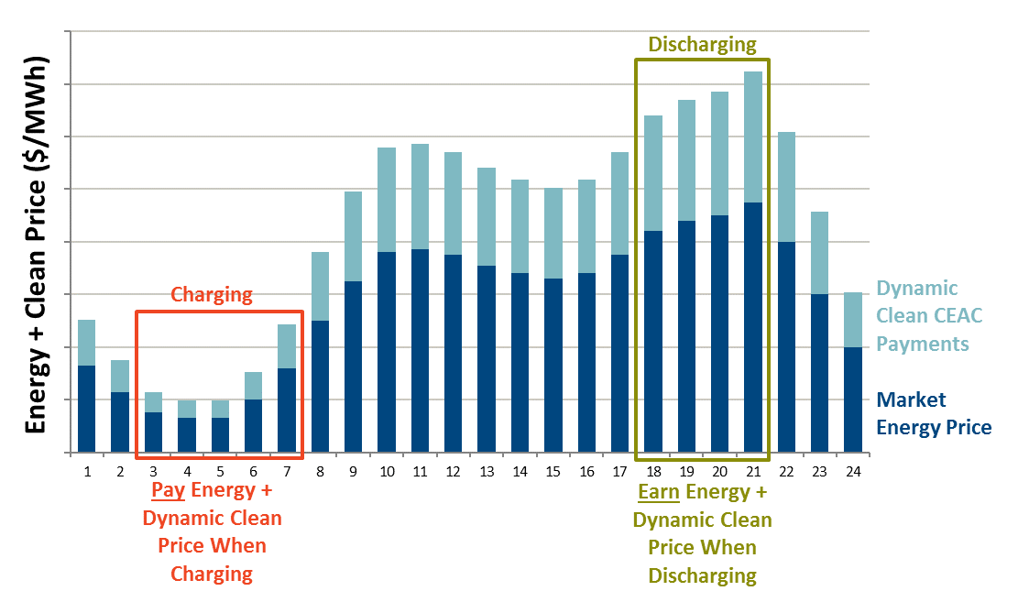
Incentives at the Right Times (Including for Storage)
Dynamic CEACs incentivize clean energy at the right times to displace the most CO₂ emissions, enabling storage to compete with other technologies
Illustration of Storage Participation with Dynamic CEACs

Slide 39
The Integrated Clean Capacity Market
A Design Option for New England’s Grid Transition
October 1, 2020
Presented to
Presented by
New England Power Pool
Kathleen Spees

Slide 40
What is an “Integrated Clean Capacity Market”?
Design Concept: Three-year forward market that attracts the optimal resource mix for reliability and state policy goals. Market would maintain key elements from today’s market, but would be a fit-for-purpose market for achieving the 80-100% clean electricity future

Slide 41
How does the Integrated Clean Capacity Market compare to other options in consideration?
Any useful path forward for New England will have to include a package of at least one solution meeting both of the central design objectives:
Solutions for Achieving
Resource Adequacy Objectives
Solutions for Achieving
State Policy Objectives
Energy-only market
Integrated planning & contracting
Forward capacity market
Carbon pricing
Integrated planning & contracting
Forward clean energy market
Integrated Clean Capacity Market
is a natural “package” for achieving a clean, reliable resource mix

Slide 42
What is an “Integrated Clean Capacity Market”?
The Integrated Clean Capacity Market would be a centralized, three-year forward market for procuring capacity and clean energy needs
Co-Optimized Auction Clearing
Supply
All resources can compete Fossil resources can sell only capacity Clean resources can sell both capacity and CEACs
Demand
Capacity: ISO-NE establishes the quantity of capacity need (mandatory) Clean Energy: States & customers establish demand for unbundled clean energy attribute credits (CEACs)
Broad regional market
Three-year forward auction
Co-optimized procurement of unbundled capacity and CEACs
7-12 year price lock-in for new

Slide 43
Key design elements
Design Element | Resource Adequacy Objectives | Clean Electricity Objectives
Responsible Entity for Defining the Need | ISO New England | State policymakers Voluntary buyers (retailers, companies)
Product Definition | Unforced capacity (UCAP MW) Keep locational specificity (as today) Consider also specifying: separate summer and winter products & “flexible” capacity needs | Clean energy attribute credit (CEAC) States would make an effort to align definitions into a uniform product to the extent possible (though multiple products would be accommodated as needed) Consider: “dynamic” CEAC product
Supply Eligibility | All clean and fossil resources are eligible ELCC-based accounting for resource-neutral capacity values (by location, season, and flexibility) | All clean resources are eligible for a “base” product All revenues are considered “in market” States can specify technology (but aim to limit the number and size to maximize competition)
Quantity to Procure | Quantity needed to support 1-in-10 Based on advanced reliability modeling that considers resource characteristics & flexibility needs in the clean grid | States and customers decide the quantity needed Pre-existing contracts are fully accounted for in this market as self-supply
Willingness to Pay | Sloping demand curves for each capacity product Hierarchy of needs reflected in price formation (e.g. import-constrained and “flexible” capacity prices are equal or greater than system/traditional capacity prices) | States submit sloping demand curves for state-mandated CEAC demand Voluntary buyers can submit price-quantity pairs to exceed state mandates

Slide 44
How might the capacity market need to evolve to align with the 80-100% clean electricity future?
What FCM elements will…
Continue to work well? | Likely need evolution?
Broad regional market Unbundled products Technology-neutral competition Co-optimized, value-maximizing auction clearing Transmission constraints reflected Marginal-cost-based pricing Private sector takes most investment risk | Incorporate a new design objective: policy goals Define separate summer and winter capacity products (separate demand and supply accounting)? Define “flexible” capacity requirements? Adopt more accurate supply accounting for all resources based on effective load carrying capability (ELCC) and accounting for plant outage rates Advanced reliability modeling for the clean grid Eliminate out-of-market interventions Fully enable all emerging technologies

Slide 45
Example: Integrated Clean Capacity Market Auction Clearing

Slide 46
Co-optimized procurement of capacity and clean energy
BIDS
CO-OPTIMIZED AUCTION CLEARING
CLEARING RESULTS
Demand
Similar to the FCM Clearing
Objective function: Maximize social surplus (area under demand curves minus cleared resource cost)
Cleared resources: Least cost resources for meeting capacity & CEAC demand
Price setting: Marginal cost of meeting incremental demand
Clearing Prices
Cleared Resources
Capacity (MW)
Clean Energy (CEACs)
Capacity (MW)
Supply
Total annual resource cost ($) Capacity quantity (UCAP MW) Clean attribute quantity (CEAC)
Clean Energy (CEACs)

Slide 47
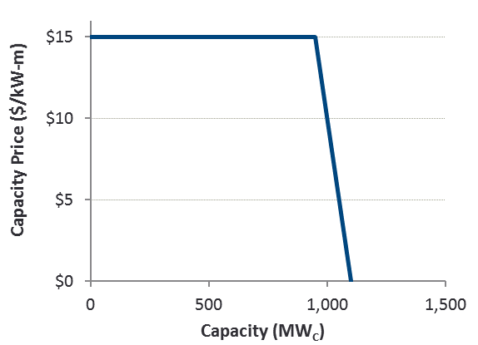
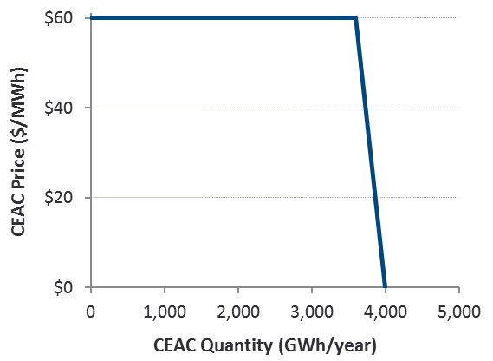
How is demand for capacity and clean energy expressed?
Separate demand curves would be used for each product
Capacity Demand Curve
Clean Energy Demand Curve
Separate capacity demand curves for:
System & zones
Summer & winter
Traditional & flexible capacity
Separate clean energy demand curves for:
Each state
Technology carve-outs
Voluntary bids
Note: Simplified example. Not intended to reflect New England.

Slide 48
How would resources offer?
Example: Resource Offers
Offer structure is one price for two products
Offer price is total annual going-forward revenue requirement
Unbundled CEAC and UCAP products clear at different prices
Seller is presumed indifferent whether revenues are earned from selling capacity or CEAC
Note: Simplified example. Not intended to reflect New England.

Slide 49
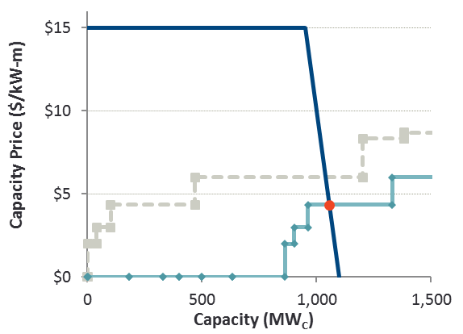
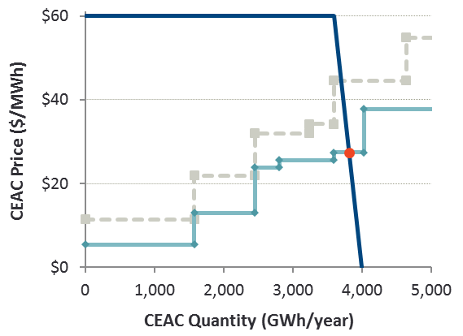
How are prices set?
Co-optimized price formation reflects marginal cost of each product.
Capacity Clearing
CEAC Clearing
CEAC Supply Curve
(If resources earned no capacity revenues)
Capacity Supply Curve
(If resources earned no CEAC revenues)
Supply Curve
(Accounting for capacity revenues)
$27/MWh
Supply Curve
(Accounting for CEAC revenues)
$4/kW-m
Note: Simplified example. Not intended to reflect New England.

Slide 50
What resources clear?
Traditional Capacity Market
Integrated Clean Capacity Market
Cleared Capacity
UCAP MW
Cleared CEACs
GWh
Cleared Capacity
UCAP MW
Cleared CEACs
GWh
EE
DR
Storage
Wind
Hydro
Solar
Nuclear
Gas
Note: Simplified example. Not intended to reflect New England.

Slide 51




How could an Integrated Clean Capacity Market guide the energy transition?
Extended simplified example illustrates the different resource mix cleared as the quantity of required CEACs increases*
0% Clean
25% Clean
50% Clean
75% Clean
EE
DR
Storage
Wind
Clear Resources (% ICAP)
Hydro
Solar
Nuclear
Gas
*Simplified example is identical to prior slides other than the quantity of CEACs required. A full time series analysis would consider how offer prices and UCAP values change over time.

Slide 52
Pros and Cons

Slide 53
Advantages and challenges to consider if pursuing an Integrated Clean Capacity Market
Advantages | Challenges
Efficiency benefits of co-optimization Builds on demonstrated successes from the current capacity market (broad competition, ability to attract investment) Flexible framework can accommodate variety of state preferences & evolving reliability needs Offer states an in-market solution to meet policy Economically balance signals to attract new clean resources, retain flexible gas plants in transition, and prevent uneconomic oversupply of capacity | Complexity Requires states and ISO to work together Governance Transitional challenges to identify and mitigate near-term impacts on customers and existing resources

Slide 54
Appendix: Example Detail

Slide 55
Example Detail: Integrated Clean Capacity Market Clearing
appendix
Resource Offers and Clearing
System-Wide Results
ICAP = Installed capacity
UCAP = Unforced capacity
CEAC = Clean Energy Attribute Credit
N = Nameplate
C = Capacity rating

